Slide 1

University of Bari Aldo Moro
Computer Science – Artificial Intelligence
Machine Learning Exam
Case Study: License Plate Recognition
Student: Gianfranco Demarco

Slide 2
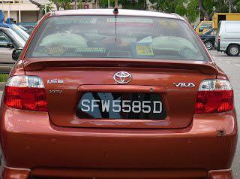
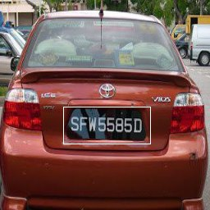
University of Bari Aldo Moro
Introduction
License plate recognition: transcribing the license plate of a vehicle starting from an image or a video
PLATE: SFW5585D
Computer Science – Artificial Intelligence

Slide 3
Introduction
In this work:
New dataset
Deep Learning Pipeline
Evaluation
Operationalization
University of Bari Aldo Moro
Computer Science – Artificial Intelligence

Slide 4
License Plate Recognition
License plate recognition (LPR) is the problem of transcribing the license plate of a vehicle starting from an image or a video.
Usually solved in 3 steps:
Identify the area which contains the plate
Perform segmentation of the individual characters
Perform Optical character recognition (OCR) on the segmented areas
In this work 2 models are implemented:
Identify the area which contains the plate (Plate detection)
Perform segmentation of the individual characters
Perform OCR on whole identified area (OCR)
(For complexity and computationals reasons)
University of Bari Aldo Moro
Computer Science – Artificial Intelligence

Slide 5
Finding a Dataset
Exploratory research of suitable datasets -> disappointing
Many car images datasets -> but not focused on license plates
Many don’t include the bounding box (ground truth)
Many don’t include the license plate transcriptions
The few which seem good -> require access from the owners
University of Bari Aldo Moro
Computer Science – Artificial Intelligence

Slide 6
Building the Dataset: Human in the loop
Key idea: using a (bad) dataset of annotated images to build a model and annotate better images
The process:
Train a (detection) model using the first dataset
Use the model to predict the plate position on the second dataset
Show the predictions. If good (judged by a human), save and move to the training set
Repeat
Take-away:
Possibly slower than annotating by hand -> probably better with a good starting point
University of Bari Aldo Moro
Computer Science – Artificial Intelligence

Slide 7
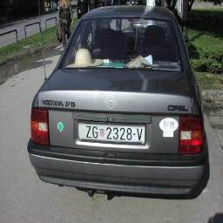
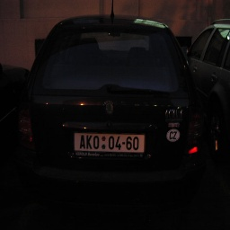
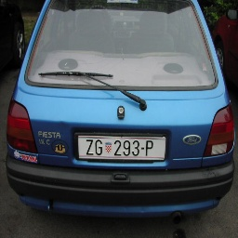
Building the Dataset
Final Dataset:
433 images
Bounding boxes annotated with human-in-the-loop process
License Plates transcribed by hand
University of Bari Aldo Moro
Computer Science – Artificial Intelligence

Slide 8
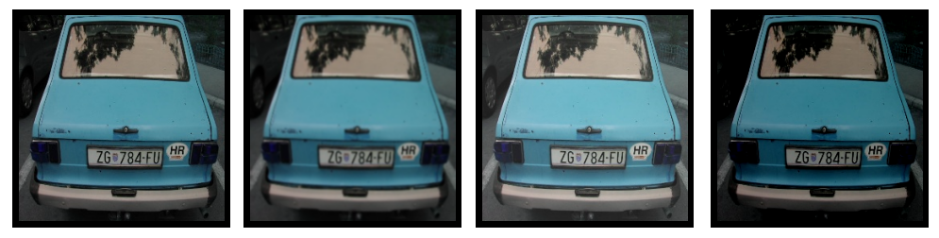
Data Augmentation
Objectives:
Increase the number of pictures
More diverse picture to increase resilience to noise
University of Bari Aldo Moro
Computer Science – Artificial Intelligence

Slide 9

Experiments
Environment: Google Colab Pro
Mostly CNNs
Validation and testing setup:
80% training data
80% training data
20% validation data
20% testing data
RMSE as loss function
University of Bari Aldo Moro
Computer Science – Artificial Intelligence

Slide 10
Experiments: Fine-Tuning the Plate Detection Model
Keras offers many pretrained models trained on ImageNet:
MobileNet and EfficientNet
Big and heavy models but performances similar to models built from scratch
University of Bari Aldo Moro
Computer Science – Artificial Intelligence

Slide 11
Experiments: Custom Plate Detection Model
Building custom CCNs architecture:
Smaller models (~10MBs)
Faster training & inference times
Performances similar to pre-trained models
University of Bari Aldo Moro
Computer Science – Artificial Intelligence

Slide 12

Experiments: the OCR model
For the OCR model:
”Microsoft Trocr Printed” in its large version (from HuggingFace hub)
No fine-tuning
University of Bari Aldo Moro
Computer Science – Artificial Intelligence

Slide 13
Final Pipeline: 1. Pre-Processing
1. Resize image to 256x256
Final Pipeline: 2. License Plate Detection
Three models are used independently : *
A model predicts the bounding box for the original image
A model predicts the bounding box for a black and white version of the image
A model predicts the bounding box for the edge-detection result of the image
These 3 model give 3 different candidate ares for the bounding boxes -> independently fed into the OCR model
*(The models were trained after applying the same transformations on the training set)
University of Bari Aldo Moro
Computer Science – Artificial Intelligence

Slide 14
Final Pipeline: 3. OCR
1. Perform 3 different OCR predictions on the 3 candidate areas -> 3 plates predicted
Final Pipeline: 4. Post-processing
Remove special characters (symbols, spaces)
Discard plates too short (<4 characters)
Discard plates too long (>12 characters)
Majority vote system for final prediction(s)
University of Bari Aldo Moro
Computer Science – Artificial Intelligence

Slide 15
Final Pipeline
Input image
Image pre-processing
Plate detection (1)
Plate detection (2)
Plate detection (3)
OCR
Post-processing
Result(s)
University of Bari Aldo Moro
Computer Science – Artificial Intelligence

Slide 16
Evaluation
Evaluation conducted for 2 different components:
Plate Detection
OCR
University of Bari Aldo Moro
Computer Science – Artificial Intelligence

Slide 17
Evaluation (Plate Detection): RMSE
The Root Mean Squared Error indicates how on average each prediction is far away by the ground truth values. The RMSE is defined as:
Used both as loss and metric
University of Bari Aldo Moro
Computer Science – Artificial Intelligence

Slide 18
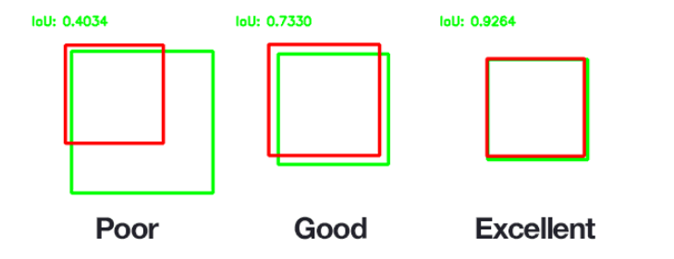
Evaluation (Plate Detection): IOU
For object detection problems, a widely used metric is Interseciton Over Union.
It measures how good is the predicted area w.r.t the ground truth
Accounts not only for how much of the region of interest is captured into the prediction, but also how much of uninteresting areas is contained as well.
University of Bari Aldo Moro
Computer Science – Artificial Intelligence

Slide 19
Evaluation (OCR): Accuracy and Levenshtein Distance
Accuracy is the measure of how many of the predictions are exactly equal to the ground truth
Levenshtein Distance measures the edit distance between two words (true plate and predicted plate)
University of Bari Aldo Moro
Computer Science – Artificial Intelligence

Slide 20
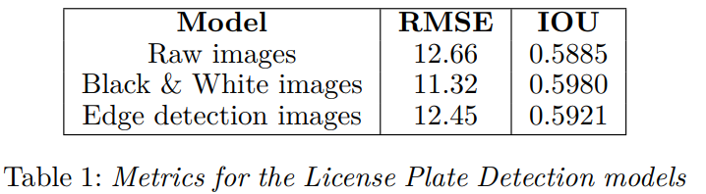
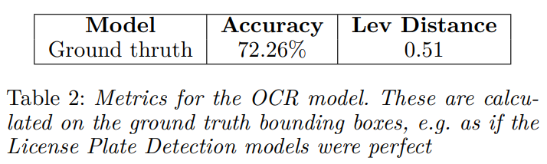
Results
University of Bari Aldo Moro
Computer Science – Artificial Intelligence

Slide 21
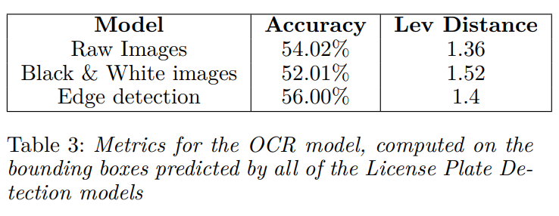
Results
University of Bari Aldo Moro
Computer Science – Artificial Intelligence

Slide 22



Operationalizing the models
Operationalize the model using:
Python web server as backend
Telegram as frontend
University of Bari Aldo Moro
Computer Science – Artificial Intelligence

Slide 23
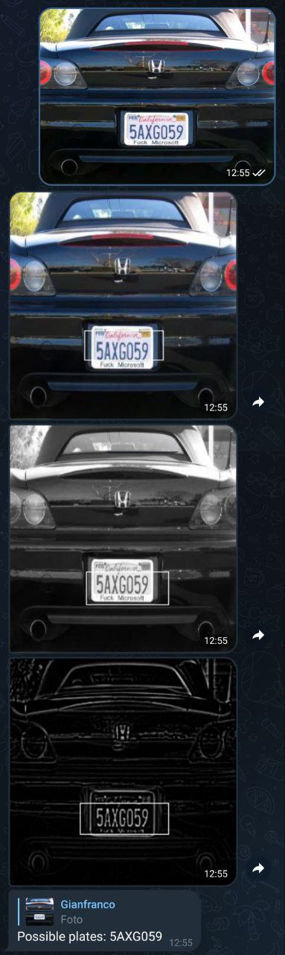
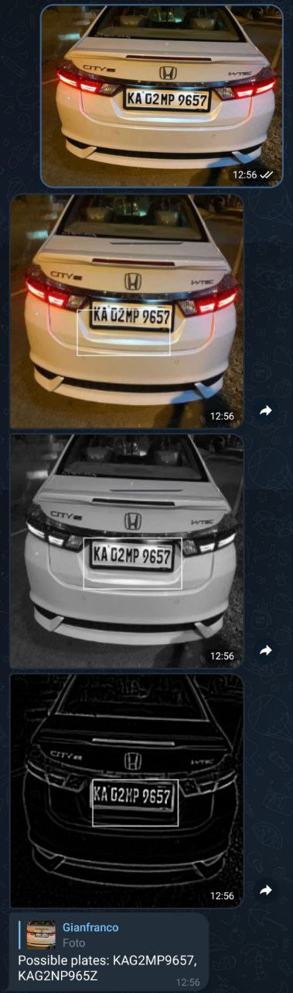
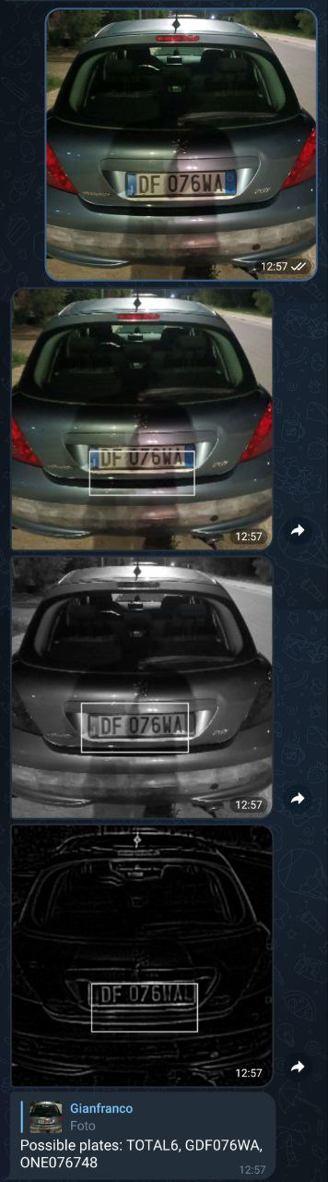
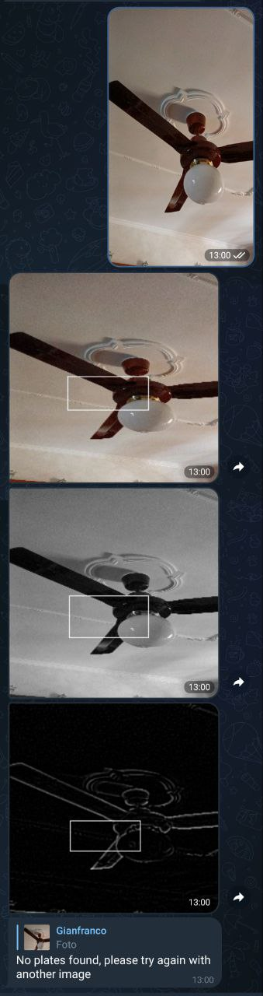
University of Bari Aldo Moro
Computer Science – Artificial Intelligence

Slide 24
Future works and improvements
Improve the dataset (more, better and diverse images)
More data augmentation (also transformations that alter the position of the plate)
Use wider images (e.g. 512x512)
Fine-tuning the OCR model
More post processing (e.g. license plate regexes)
University of Bari Aldo Moro
Computer Science – Artificial Intelligence

